Slide 1
Map, Food, & Smiles
Lo Yi, 羅頤
20240916 TEN MFS.key

Slide 2
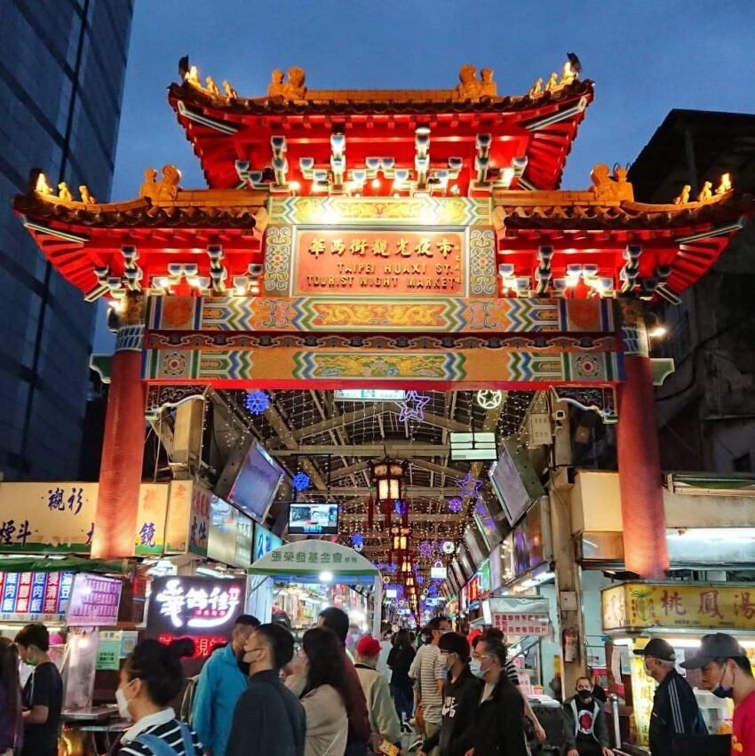
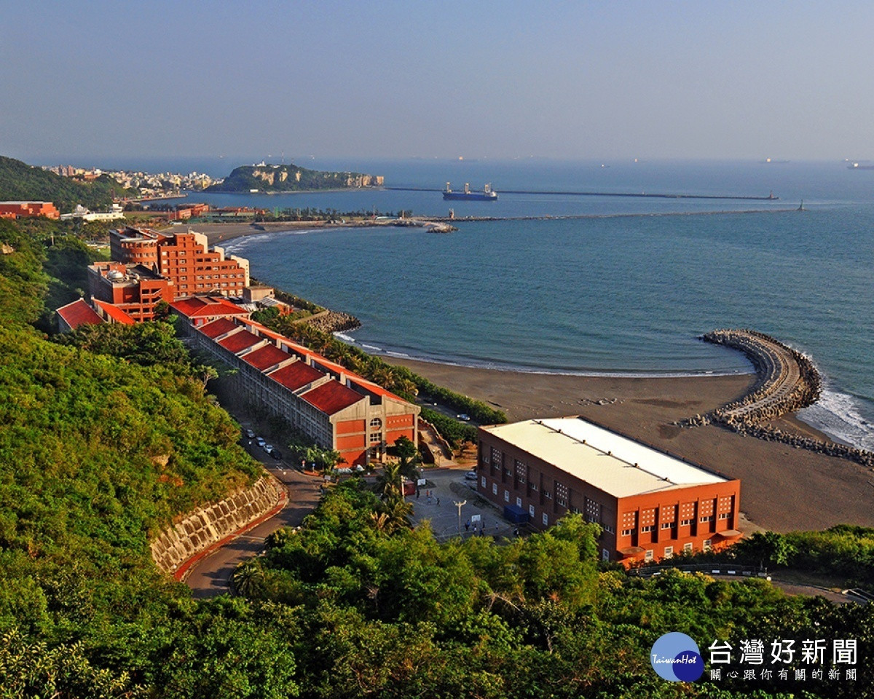

Maps
2000: Wanhua, Taipei
2019-2024 NSYSU MIS
2024-present: NYCU
Department of Information Management and Finance
Title

Slide 3
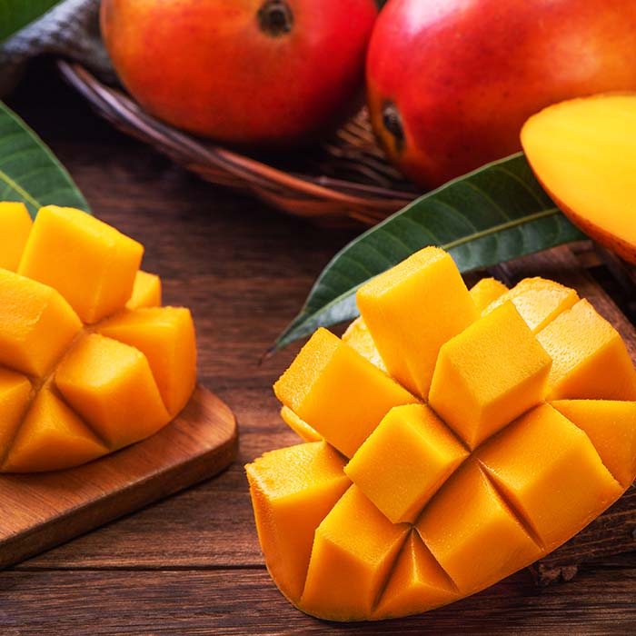
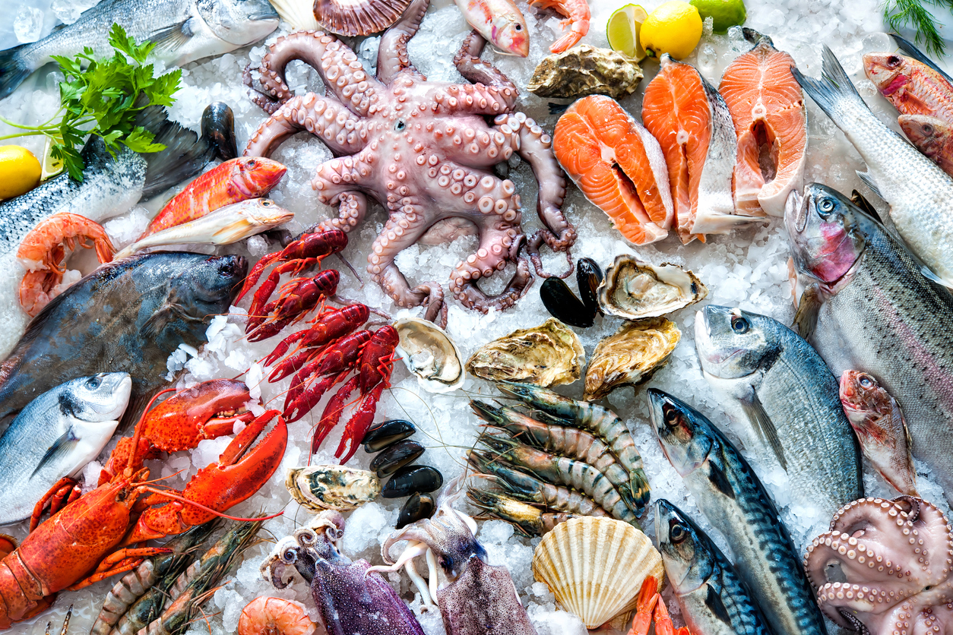
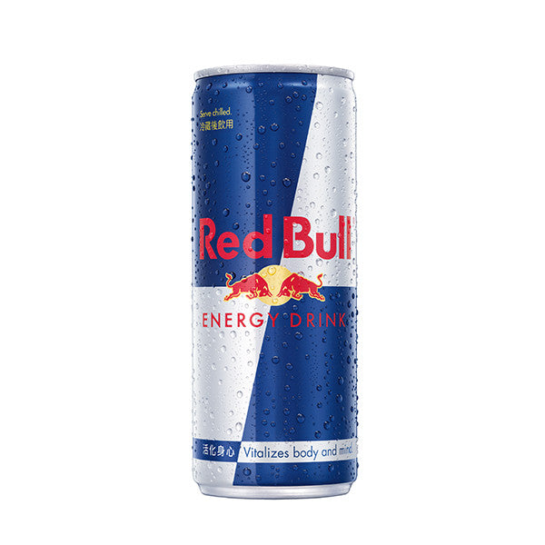
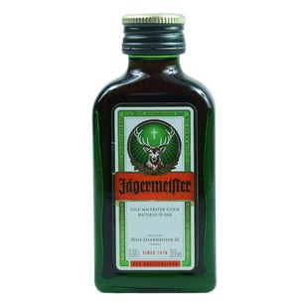
Food
Seafood
Mango
Redbull&
Jägermeister
Title

Slide 4
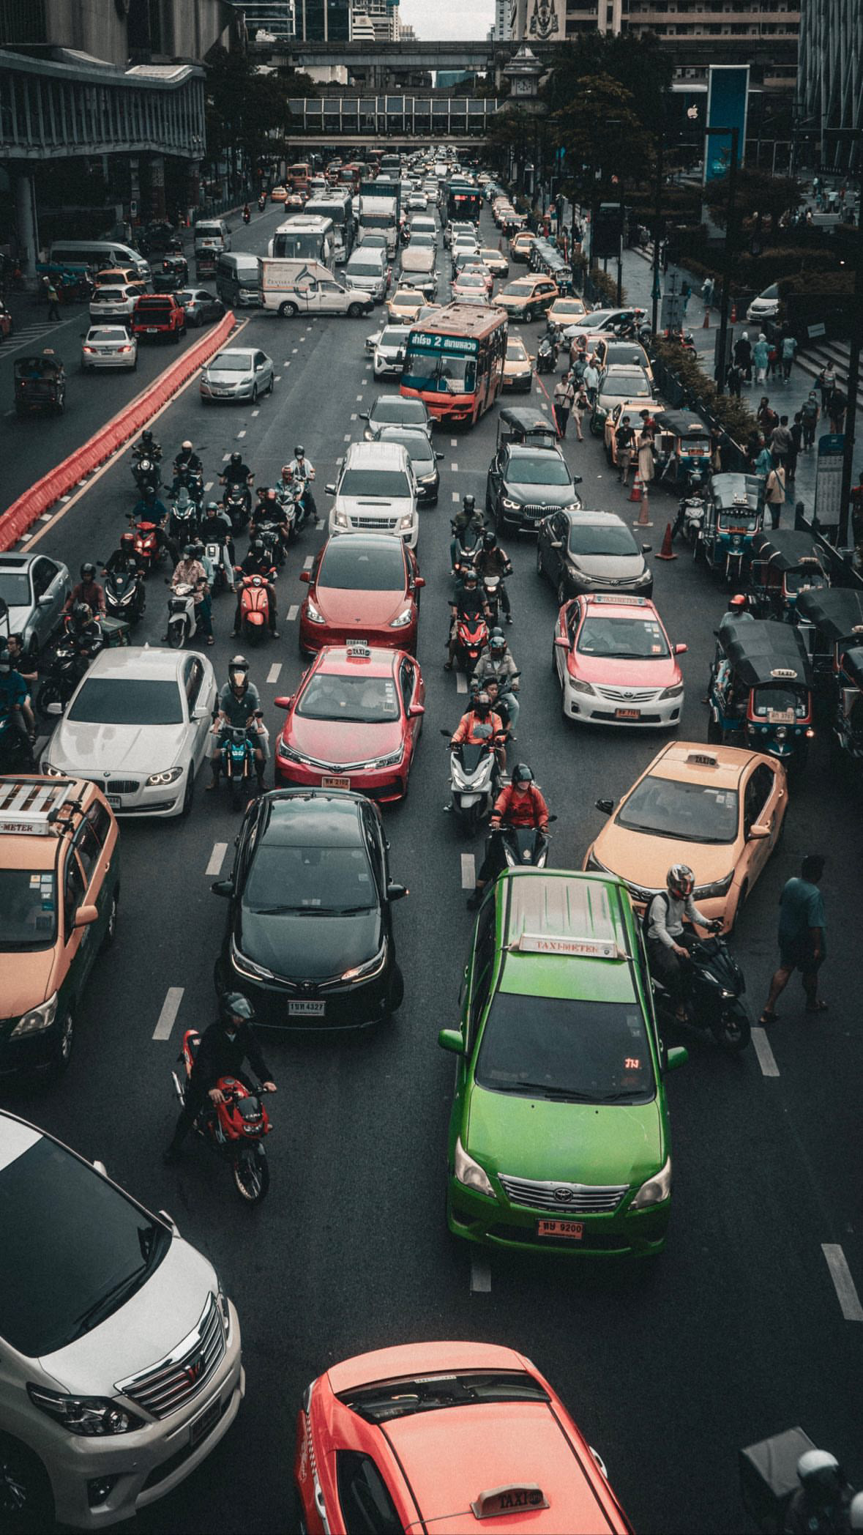
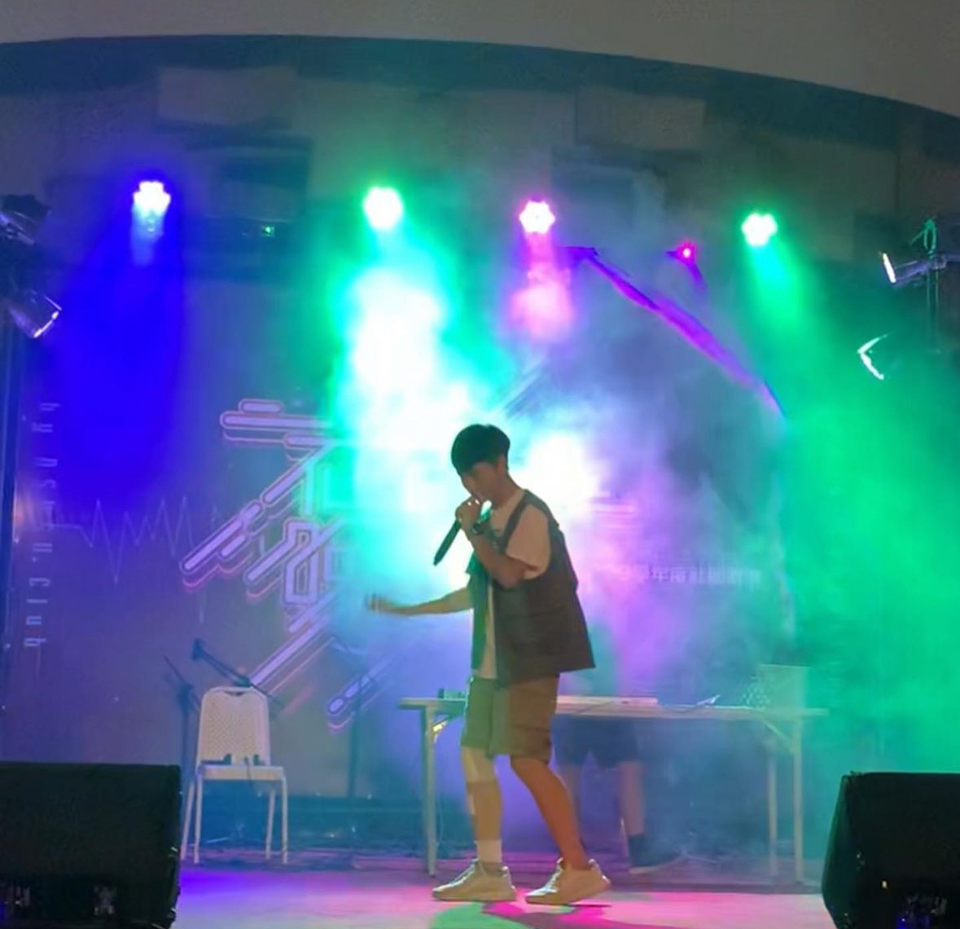
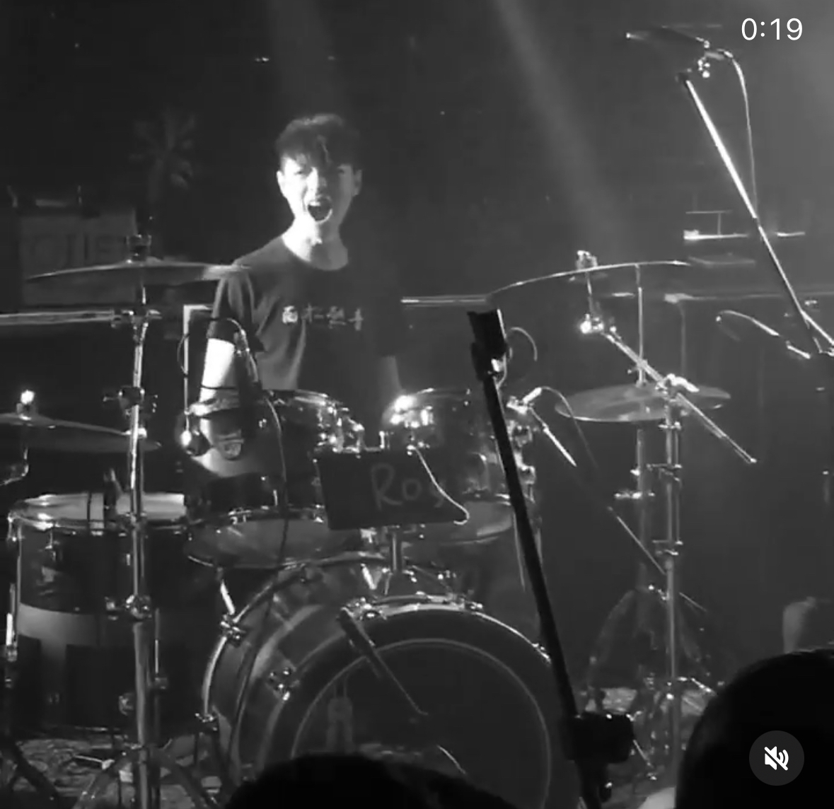
Smiles
Travelling
Rap
Play drums

Slide 5
Project
Technical trading Based on Machine Learning

Slide 6
Thanks for listening
Title

